Slide 1
NATURE TOURISM
BY
PRIYANKA

Slide 2

INTRODUCTION
In this Application ,Users are able to select the tourism package and they can even modify the places according to their choice.
First User need to be registered on the website,
Then they will get the access for the packages.
The main aim of the website is to provide most
convenient way of travelling for the users by
selecting the places of their choice.

Slide 3
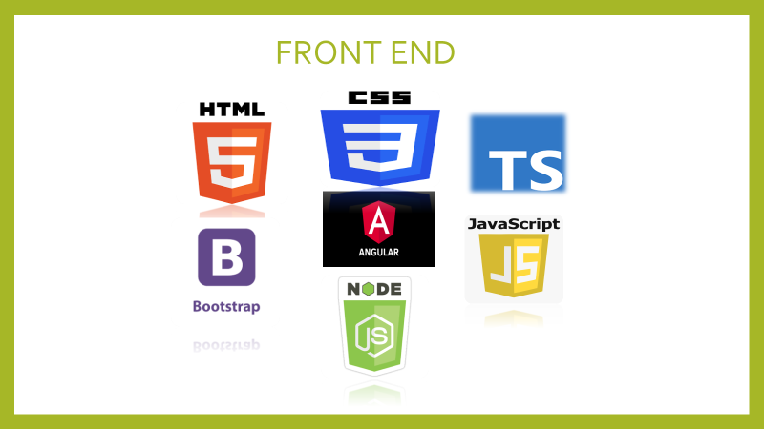
FRONT END

Slide 4


BACK END

Slide 5
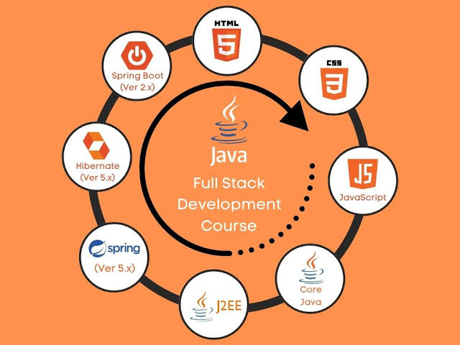
ARCHITECTURE

Slide 6
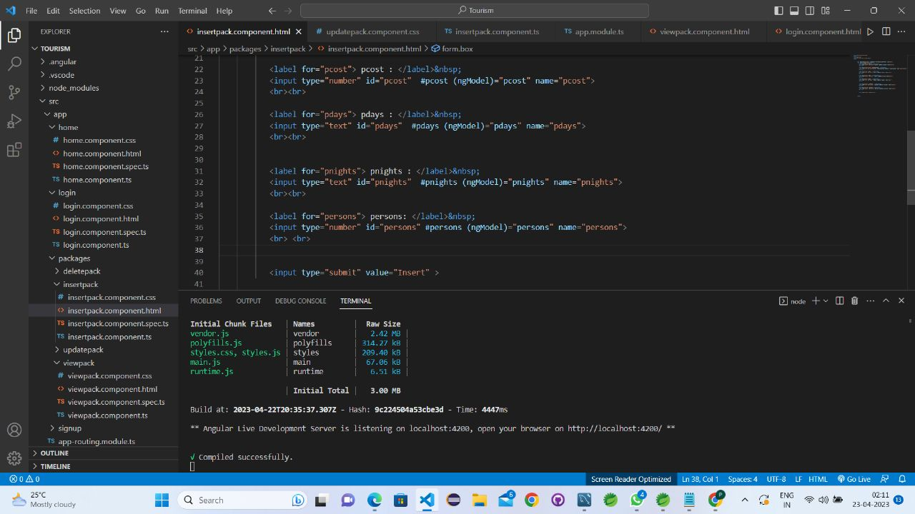
TOURISM-ANGULAR

Slide 7
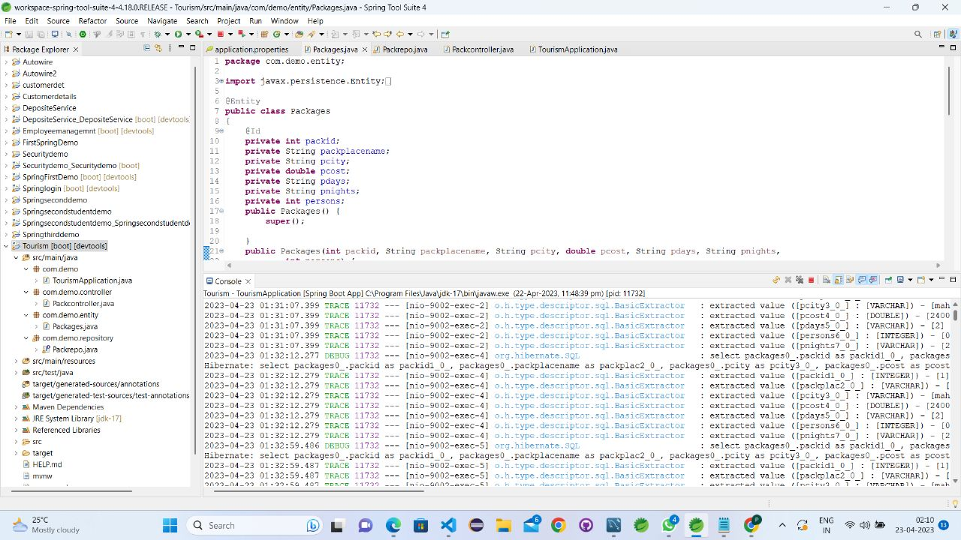
TOURISM-SPRING BOOT

Slide 8
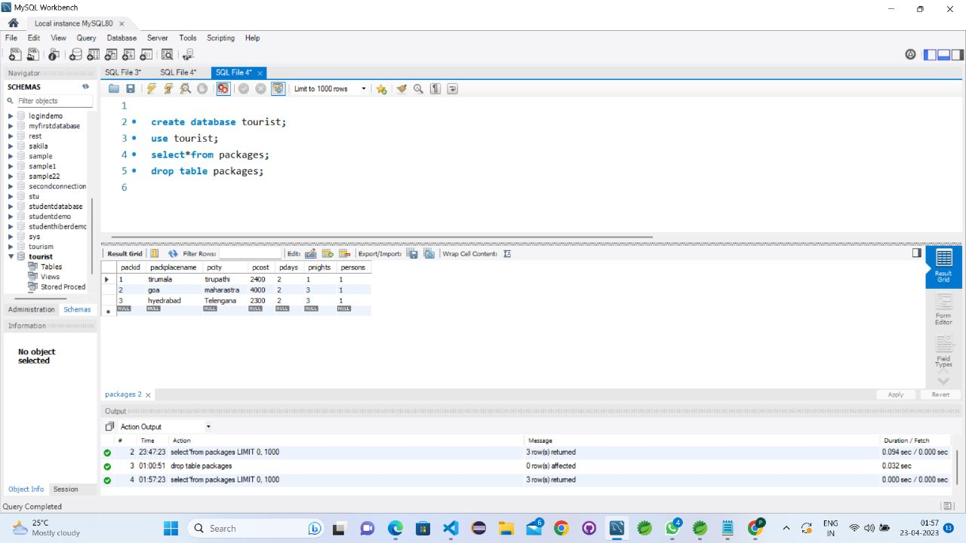
TOURISM -DATABASE

Slide 9
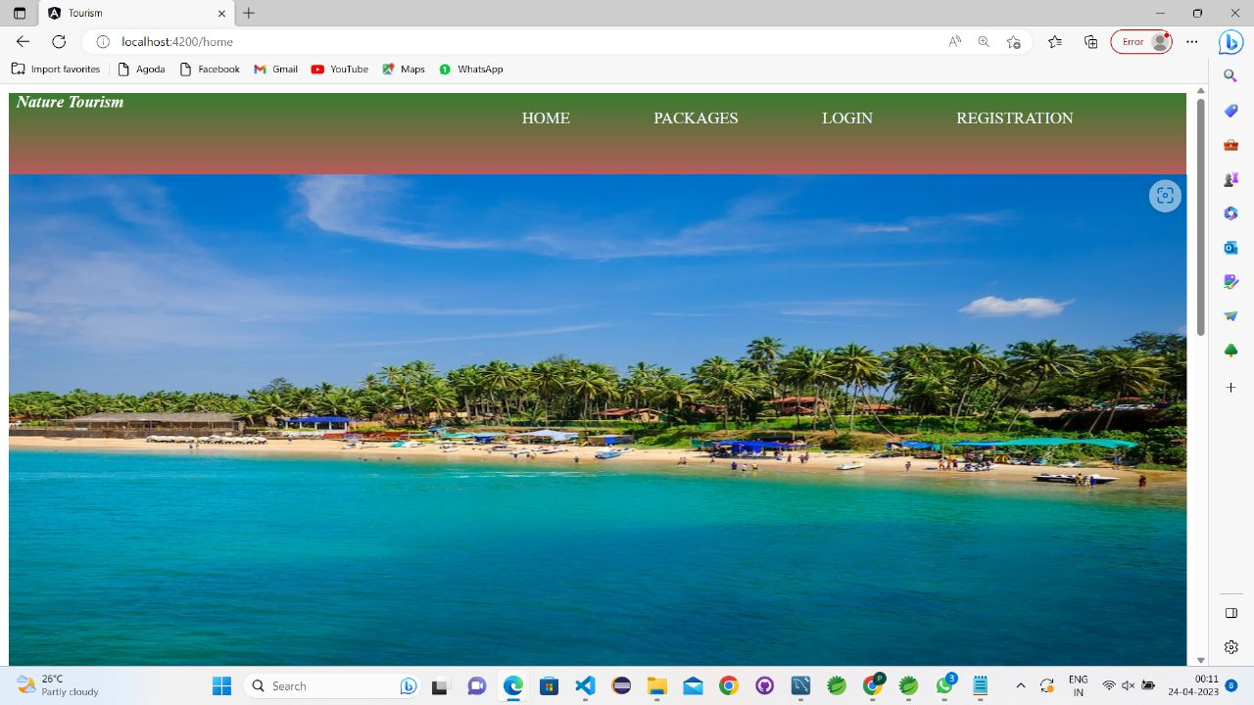
TOURISM -HOMEPAGE

Slide 10
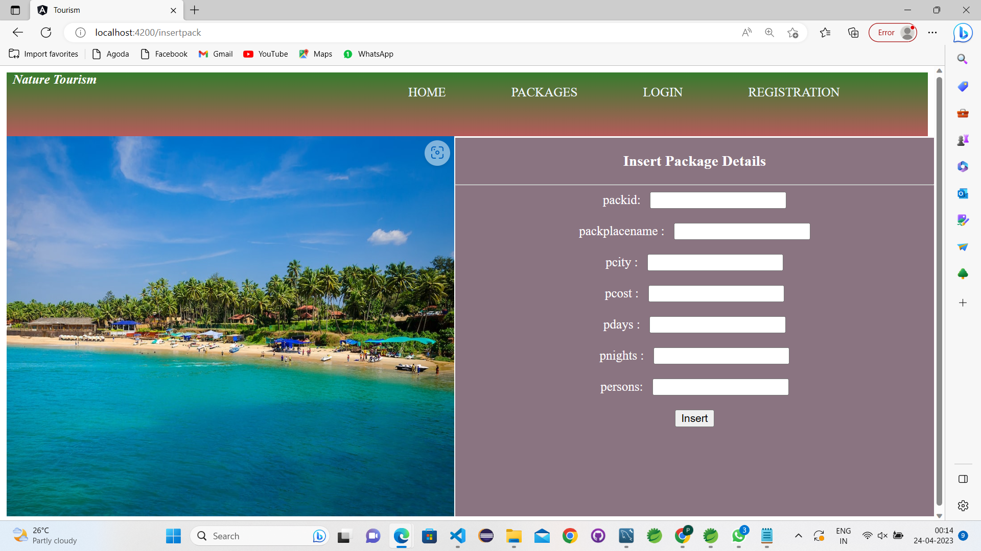
CURD -OPERATIONS

Slide 11
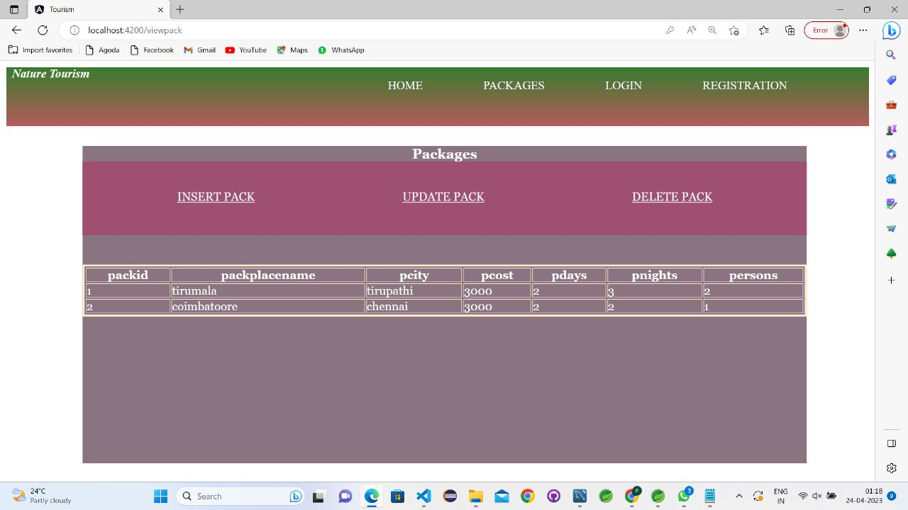

Slide 12
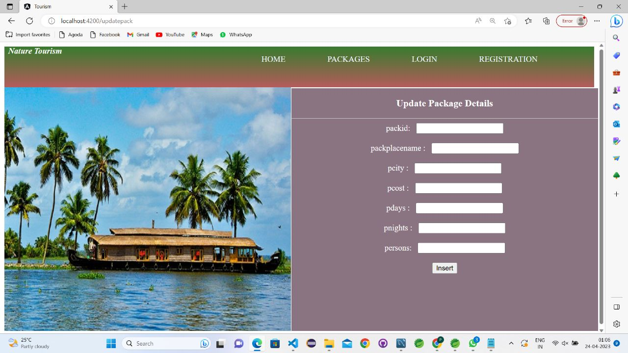

Slide 13
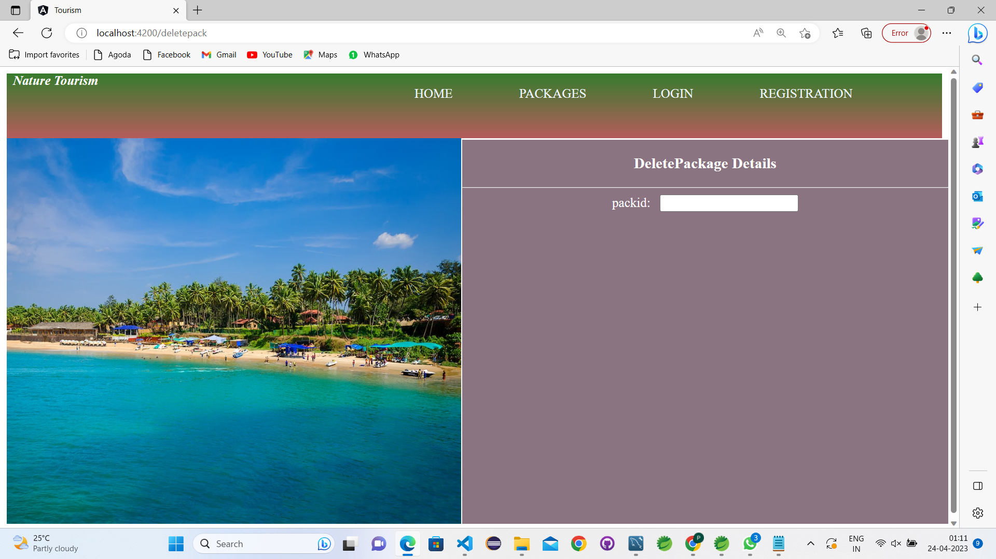

Slide 14
FUTURE SCOPE OF THE PROJECT
In Future , Users are able to compare price of the packages with other websites. So they can choose the best price.
More destination places will be added in future at best pricing.

Slide 15
GITHUB LINK
https://github.com/PRIYA4497/Tourism-Fullstack-project.git

Slide 16
THANK YOU

